Slide 1
Overview of the Training
Introduction to the training
Lecture 1 – Introduction to the BuPuSa-FDM and its potential use
Lecture 2 – Overview of data, models and methods, validation
Lecture 3 – Flood and drought monitoring concepts and methods
Lecture 4 – Flood and drought forecasting concepts and methods
Self-guided exercises
Feedback and way forward

Slide 2
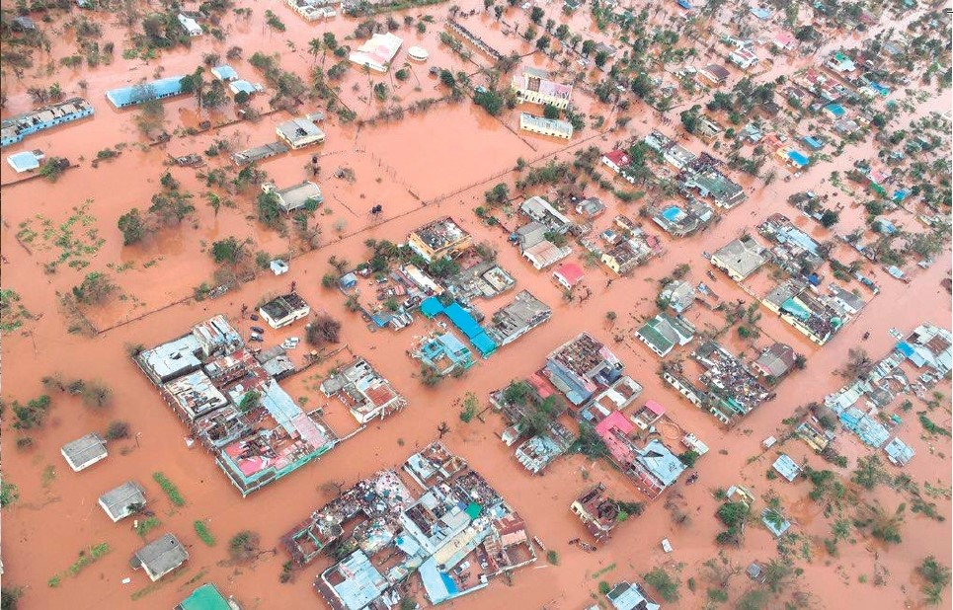



Hydrometeorological Hazard Early Warning for the Buzi-Pungwe-Save (BuPuSa) Transboundary Basin
Technical Training and Knowledge Exchange Workshop
Prof. Justin Sheffield (sheffield.justin@gmail.com)
Princeton Climate Institute, USA
University of Southampton, UK

Slide 3
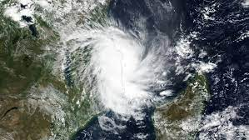
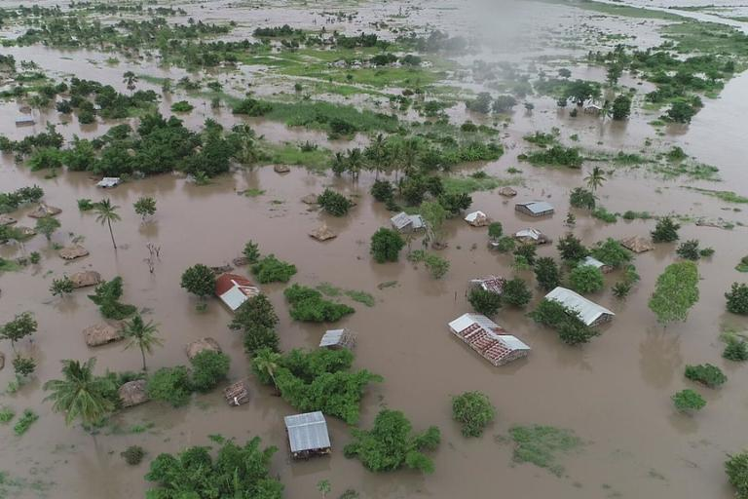
Introduction to the Workshop
Motivation:
Hydrometeorological hazards (cyclones, pluvial and fluvial floods including flash floods, droughts, heatwaves, landslides, and wildfires) are perennial challenges
They are expected to become more severe and frequent under climate change and human influences such as land use change.
Use of early warning (EW) information is crucial to addressing these challenges, alongside robust mitigation and adaptation measures to reduce the impacts of hazards.
Collectively there is wide experience and expertise across institutions in the region in climate and hydrological monitoring, forecasting and early warning.
Sharing of expertise would be beneficial to identifying best practice, and gaps in the implementation and use of Early Warning Systems (EWS).
Cyclone Kenneth (Guardian)
Cyclone Idai (WMO)

Slide 4
Objectives and Expected Outcomes of the Workshop
Overall Aim:
This 2-day workshop aims to bring together relevant stakeholders from Zimbabwe and Mozambique to exchange knowledge, enable collaboration, and build capacity and ambition in the implementation of EWS.
Objectives:
To exchange knowledge on the development, implementation and use of early warning of hazards.
To provide technical training in the new basin scale flood and drought monitoring system (BuPuSa-FDM).
To co-develop a way forward for potential technology transfer and implementation for early warning in the region.
Expected Outcomes:
Knowledge exchange of the flood/drought situation and risk reduction capacity in Zimbabwe and Mozambique.
Raised awareness of EWS and its benefits.
Knowledge transfer on the BuPuSa-FDM.
Co-developed pathway forward to improving EW.

Slide 5
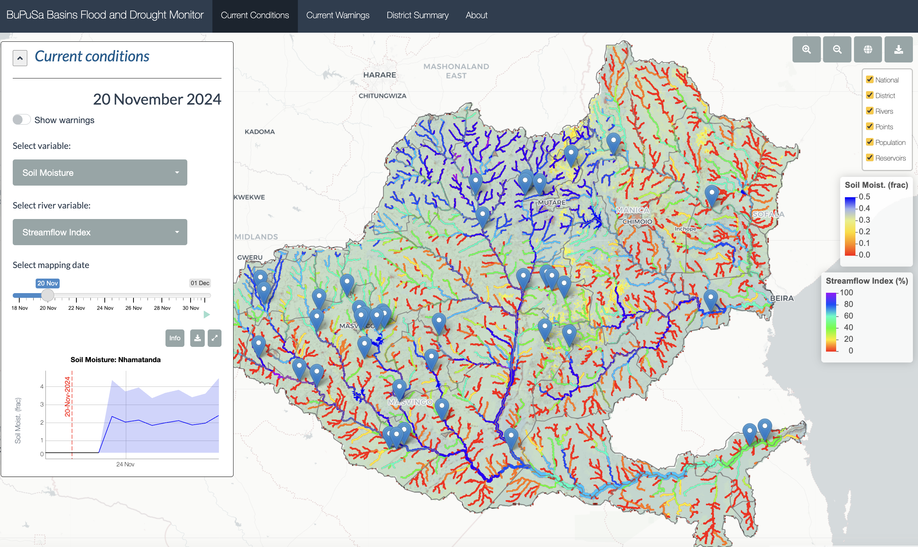
Buzi-Pungwe-Save Flood and Drought Monitor
“BuPuSa-FDM”
An online platform for monitoring and early warning of water resources, floods and droughts, close to real-time for the BuPuSa basins
There is potential to leverage from the design and implementation of this pilot system to progress EW for the region.

Slide 6
Agenda
Knowledge exchange
Day 1 AM | Opening remarks
 | Overview of objectives and proposed outcomes of the workshop
 | Introductions and background to each represented institution
 | Discussion of strengths and gaps in current approaches to EWS
Training in the BuPuSa-FDM
Day 1 PM | Introduction to the FDM and its potential use.
 | Overview of data, models and methods.
 | Flood and drought monitoring – concepts and methods/data
 | Flood and drought forecasting – concepts and methods/data
Training in the BuPuSa-FDM
Day 2 AM | Exercises in the use of the FDM
 | Feedback and initial validation of the system
Way forward
Day 2 PM | Discussion on principles of a multi-hazard system
 | Identification of barriers and opportunities to developing a multi-hazard system
 | Way forward including opportunities to leverage from the FDM and other approaches

Slide 7


Introductions
Zimbabwe
The Zimbabwe Meteorological Services Department ( ZMSD)
The Department of Civil Protection( DCP)
The Zimbabwe National Water Authority(ZINWA)
Mozambique
INAM: Instituto Nacional de Meteorologia (Mozambique National Institute of Meteorology) ; INAM Sofala, INAM Manica, INAM Inhambane
INGD: Instituto Nacional de Gestão e Redução do Risco de Desastres (National Institute for Disaster Risk Management and Reduction)
ARA Centro (Water Administration Institute for the Central Region of Mozambique), Buzi
ARA Centro, Pungue
ARA-Sul (Water Administration Institute for the Southern Region of Mozambique)
ICS: Instituto De Comunicacao Social

Slide 8


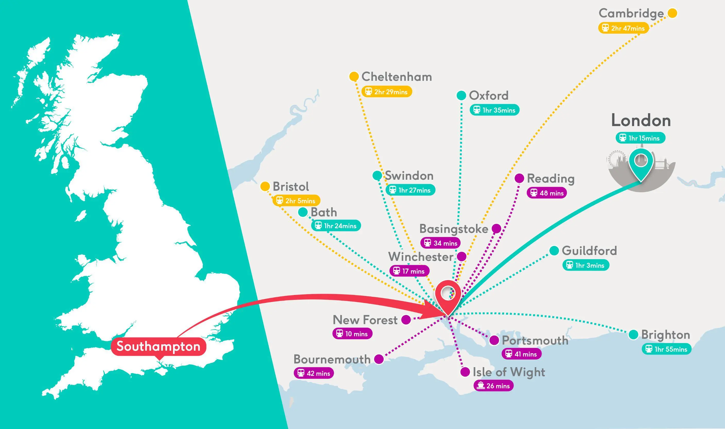
Who we are
Prof. Justin Sheffield
Over 30 years experience in climate and hydrology research and applications
>200 peer-reviewed publications, books and book chapters
Multiple awards: American Meteorological Society Robert E. Horton Lecturer; UK Royal Society Wolfson Research Merit Award; Prince Sultan Bin Abdulaziz International Prize for Water: Creativity Prize; European Geosciences Union Plinius Medal for natural hazards research

Slide 9
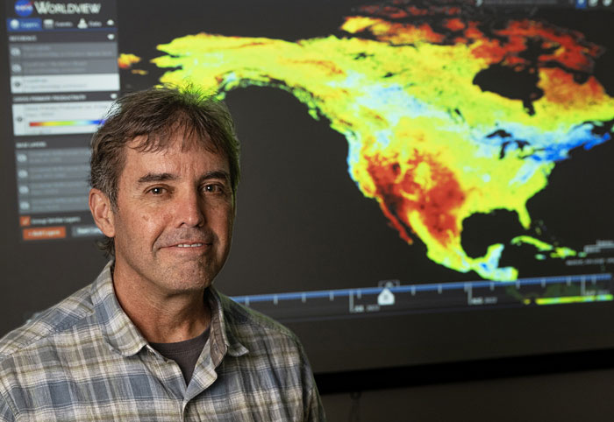
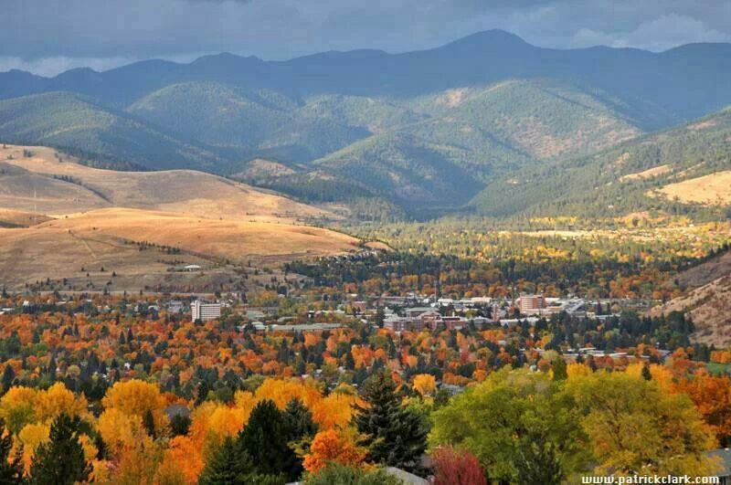
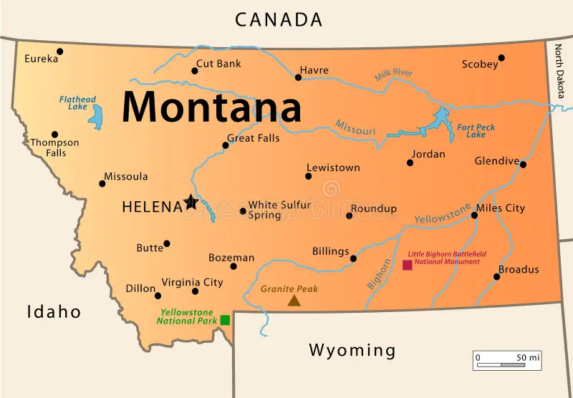

Who we are
Prof. John Kimball
Over 30 years experience in climate-ecosystem interactions research and applications
>180 peer-reviewed publications, books and book chapters
Expert in developing new techniques and applications for environmental monitoring using remote sensing observations collected from optical-infrared and microwave sensors.
Dr Jinyang Du, Research Scientist

Slide 10
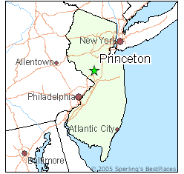






Who we are
Princeton Climate Institute (PCI) is a non-profit organisation whose missions is to organise global research in hydrology and climate science to benefit governments and populations in need.
PCI brings together scientists and experts from around the world to shed light on water and climate risks and to work with NGOs and government agencies to mitigate those risks.
PCI was founded in 2020 by Prof. Justin Sheffield, Prof. Eric F. Wood, Prof. John Kimball, Catherine McVay Hughes, and Dr. Tony Busalacchi.
The board of directors also includes Prof. Jean-Marie Kileshye Onema, from the University of Lubumbashi, DR Congo.

Slide 11
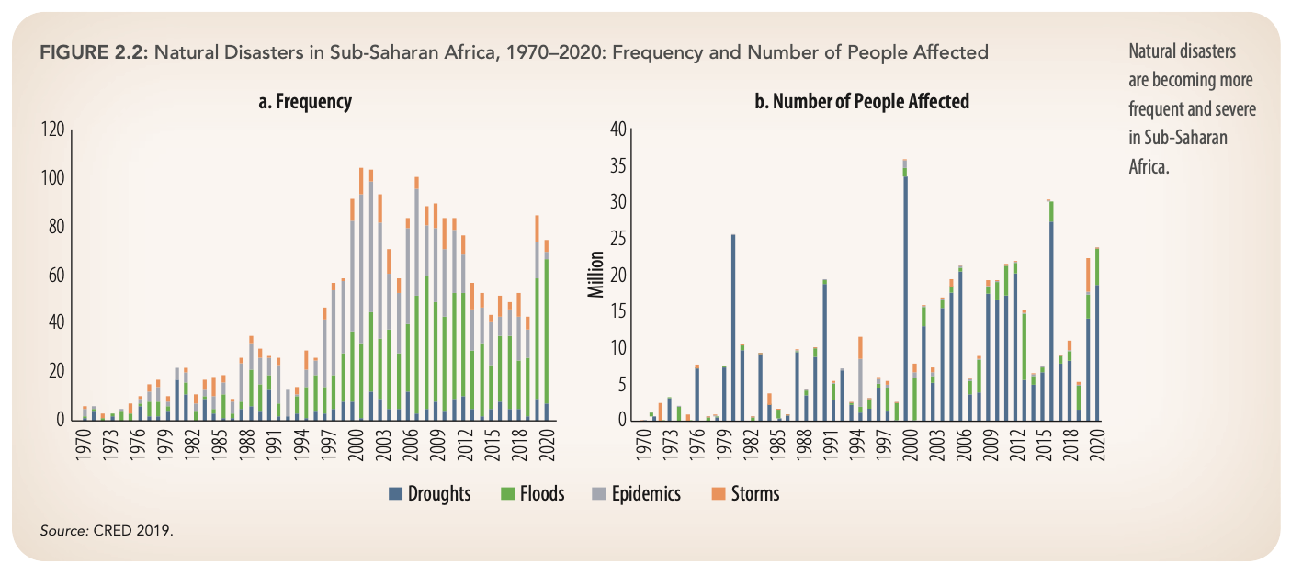
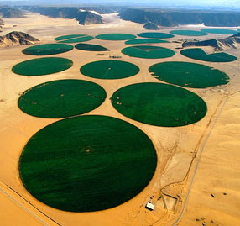

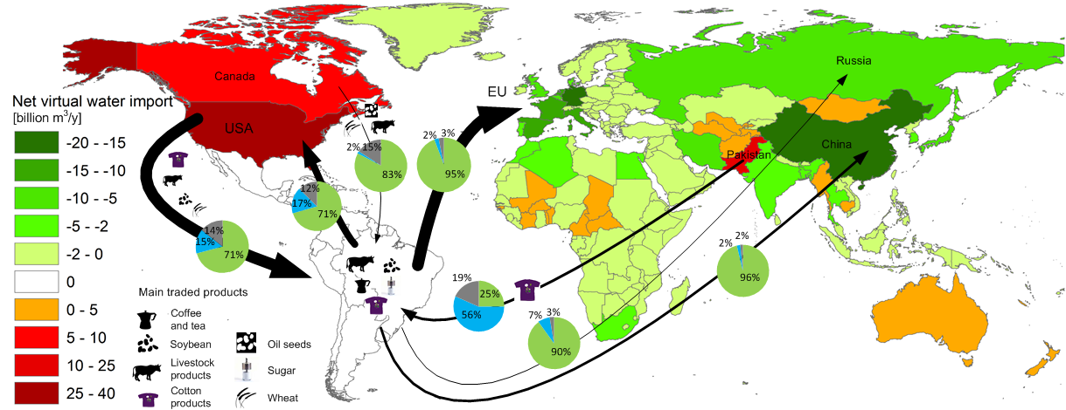
What we do
Water is key to climate adaptation and mitigation, equitable and sustainable development
There are several challenges:
Increasing demand, e.g. population growth, urbanization, development
More frequent and extreme hydrological events under climate change
Impacting on the poorest and most vulnerable
Over-exploitation of water, but under-exploitation in developing regions
These are global and systemic:
Half the world’s population already experiencing severe water scarcity at least one month per year
Global connectedness through trade, energy supply, transboundary rivers, transport, … indicates systemic risks
Potential for longer-term impacts of structural transformations, migration and conflict
There is a need for:
More equitable / sustainable access to water, food, energy, …
Resilience across water dependent sectors, from community to regional scale
Increasing extreme events
In sub-Saharan Africa
Population growth in water stressed regions
Unsustainable groundwater pumping
Global dependencies via virtual water trade

Slide 12
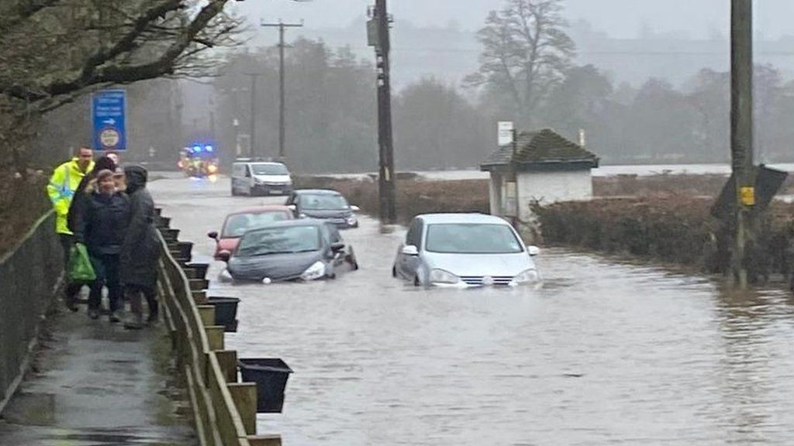
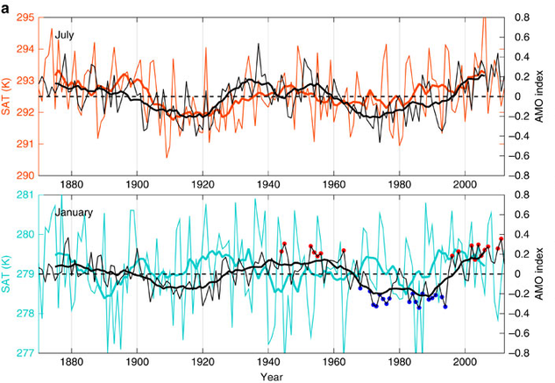
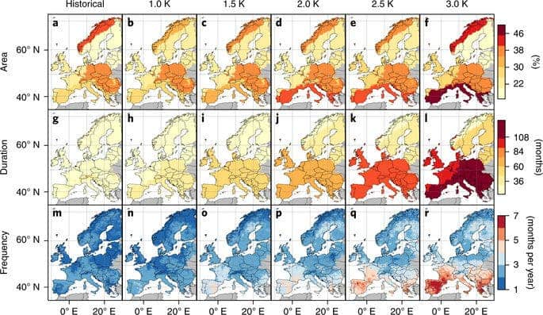
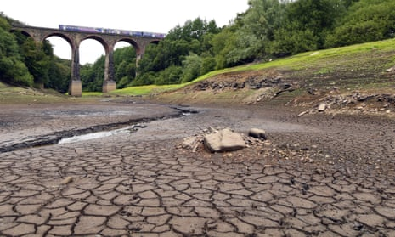
Water resilience is important across a range of interconnected time scales
Now
The next decade
The next generation
Recent flooding UK
Inter-annual to decadal climate variations in the North Atlantic
Future changes in European drought under different warming levels
Drought, UK, 2018
Responding to extreme hydrological events
Planning for climate variability and impacts on water related sectors
Adapting to long-term climate change and its feedbacks with water
Increasing uncertainty into the future
Increasing need to integrate across sectors (water, food, energy, land, …)
Increasing options to integrate solutions across time scales

Slide 13
We develop climate and hydrological predictions and risk assessments to address water resilience challenges,
across time scales and for a range of applications/sectors
Insurance
Reinsurance
Planning
Design
Insurance
Govt.
Utilities
Aid Agencies
Govt. Alerts
Utilities
Insurance
Commodities
Insurance
Hydro, Energy, Ag.
Resource Assessment
Infrastructure
Planning
Historic
Risk
Flood and Drought Impacts
Flood
Prediction
Drought Early
Warning
Changes in
Risk
Historic data
Real-time
monitoring
Short-term
forecasts
Seasonal
forecasts
Future climate
projections

Slide 14
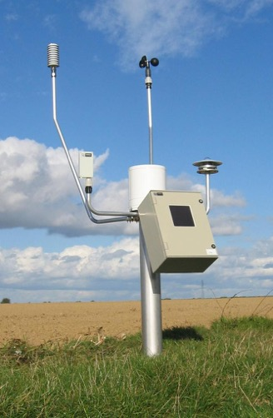

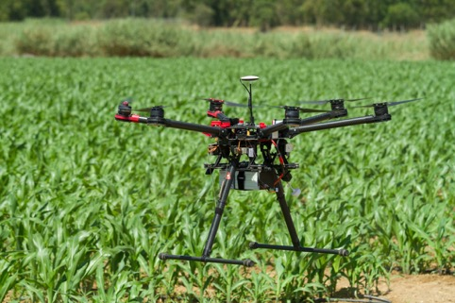
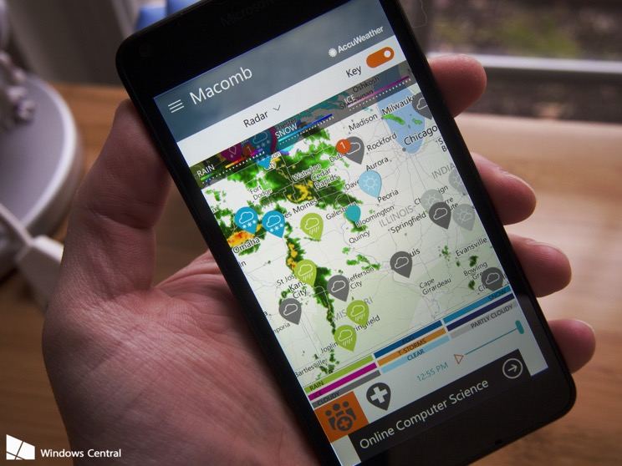
Research and Applied Tools that we use
In-situ Data
Remote Sensing
Hydrological Models
Climate Models

Slide 15
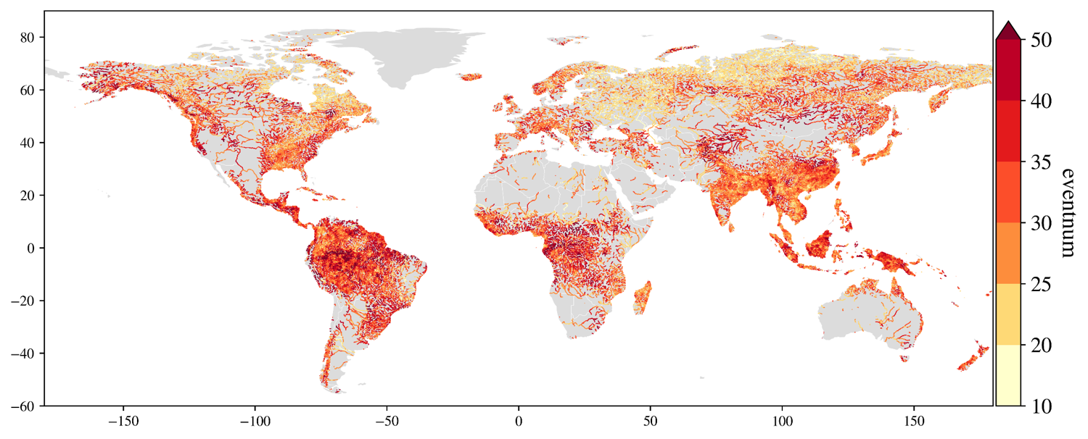
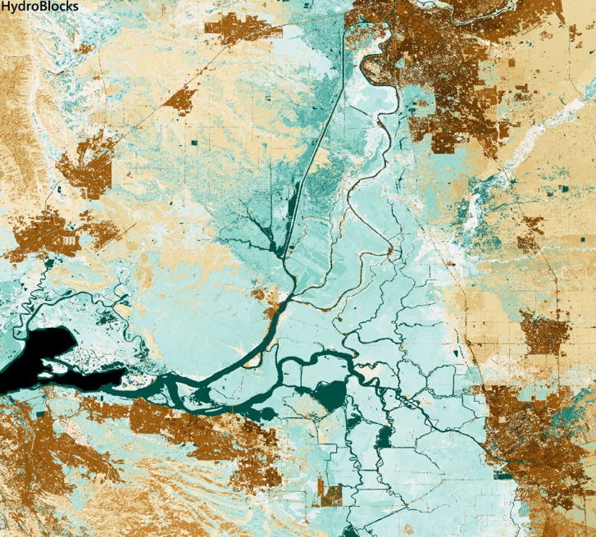
Global to Local Hydrology at High-Resolution (Street and Field)
Number of events
Number of flood events during 1980-2019
(for river reaches with flood threshold ≥ 100 m3/s)
Advanced datasets, models, statistical methods
At relevant, decision making scales
River basin to meter scales
Volumetric soil moisture,
Bay Area/Sacramento, 3-Jan-2018

Slide 16
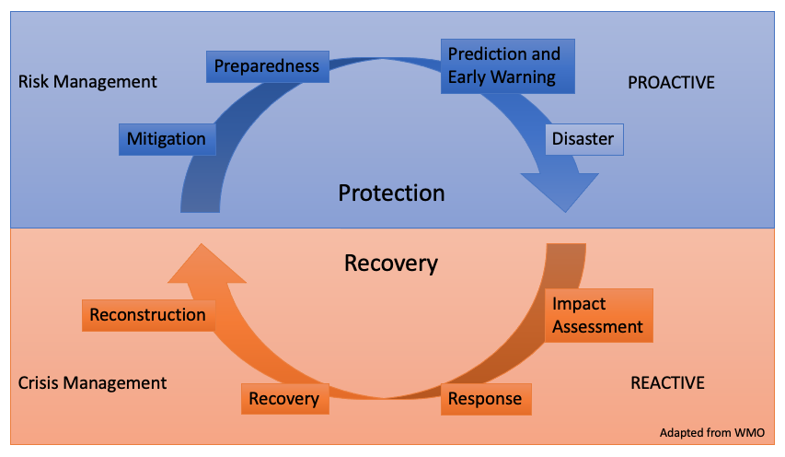




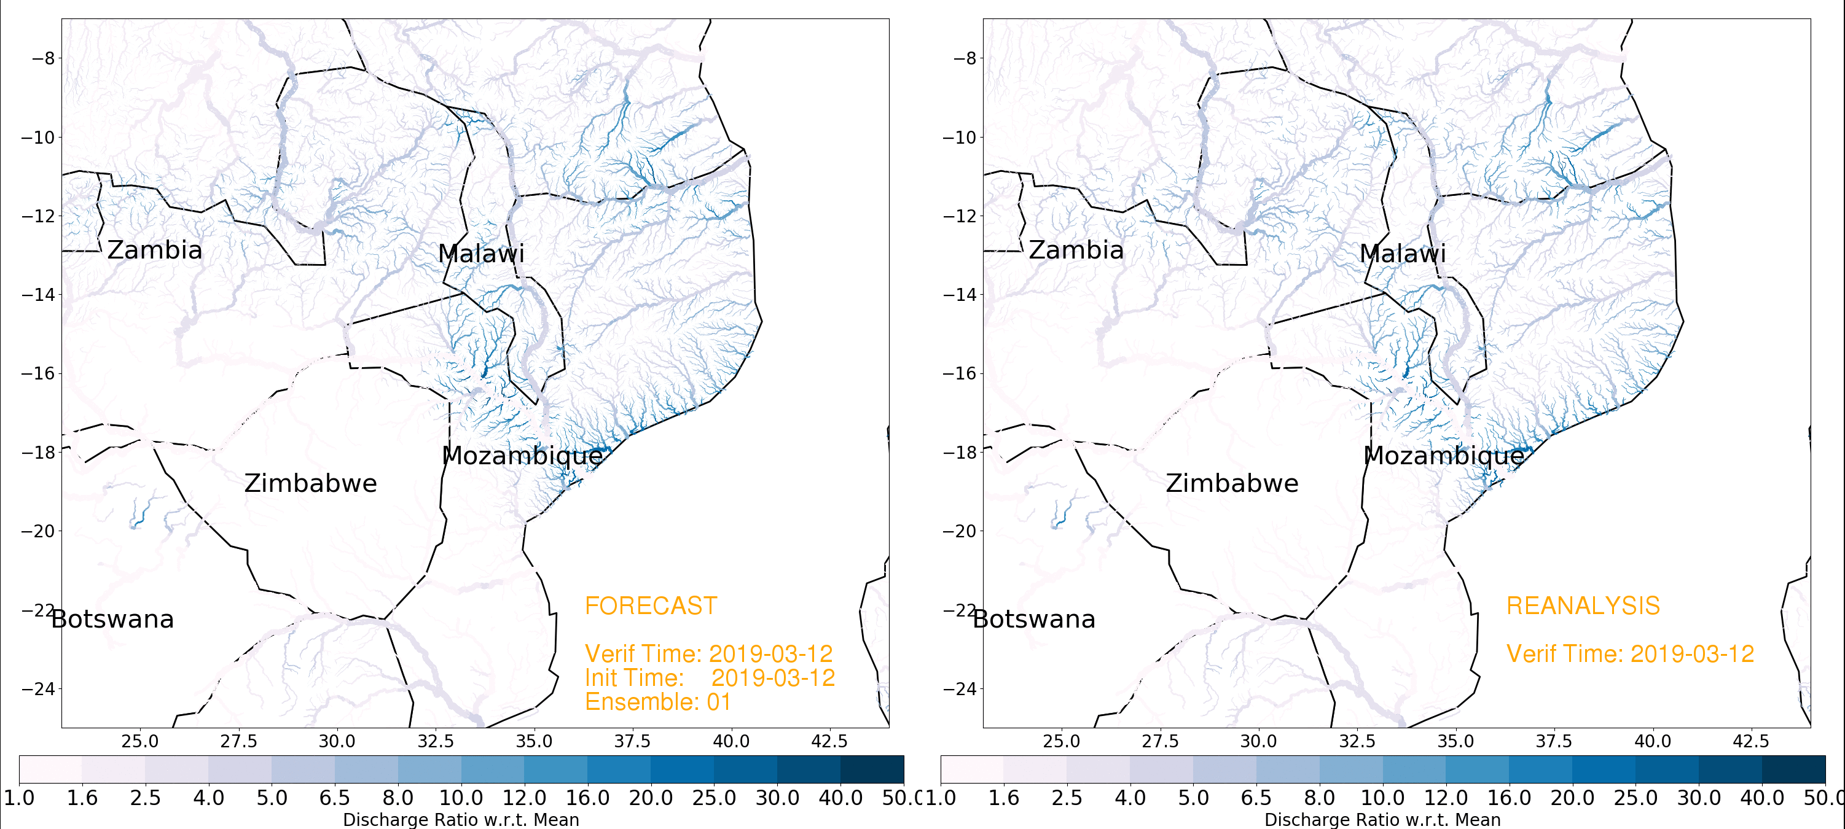
Example 1 – Enhancing resilience to flood/drought risk through early warning
Four elements of an early warning system
Risk assessment and mitigation
Real-time monitoring and warning
Dissemination and communication
Planned response and recovery
Example 7-day forecast of flooding from Cyclone Idai, March 2019
A range of things needs to be put in place to increase short-term resilience to floods and drought
Real-time monitoring and early warning is a key element of any risk management approach
Integration of climate/hydrological models + satellite + in-situ data has enabled this even in data-scarce regions
Coupled with local dissemination (e.g. community radios) and knowledge (e.g. early action plans)

Slide 17

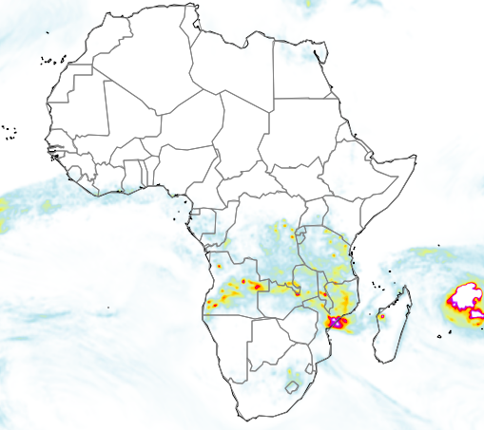
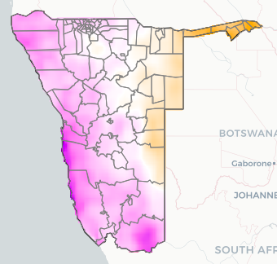
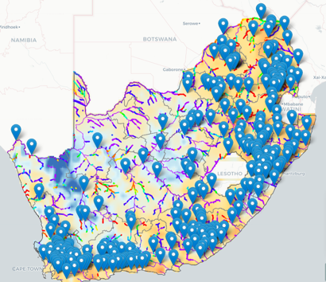
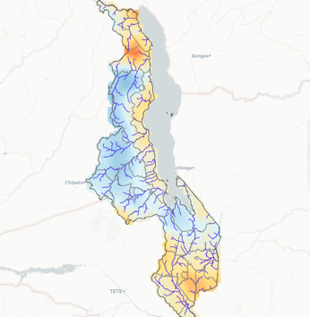
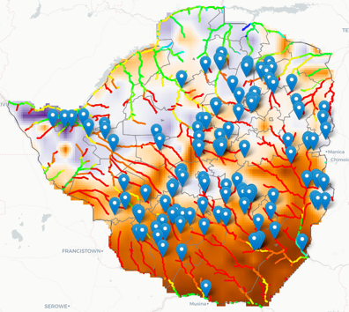
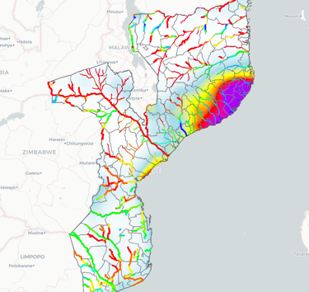
African and National Monitoring/EW Systems
We have been running the continental African Flood and Drought Monitor (AFDM) system since 2008
We also provide national systems for 9 countries which are derived from the AFDM
They provide more detailed and comprehensive information, tailored to the national scale
Higher-resolution, more relevant variables, local validation
With potential to incorporate local knowledge, requirements, data …
The BuPuSa-FDM takes this to the next level of hyper-resolution monitoring and EW at the field/community scale

Slide 18
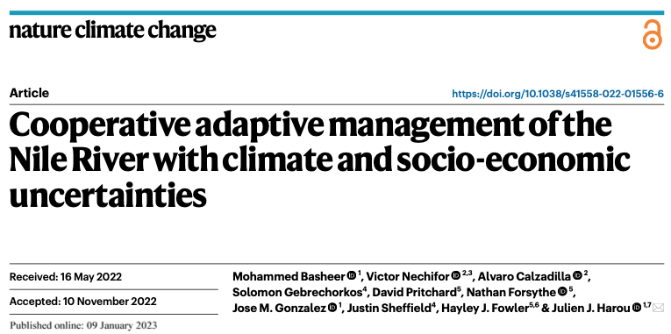
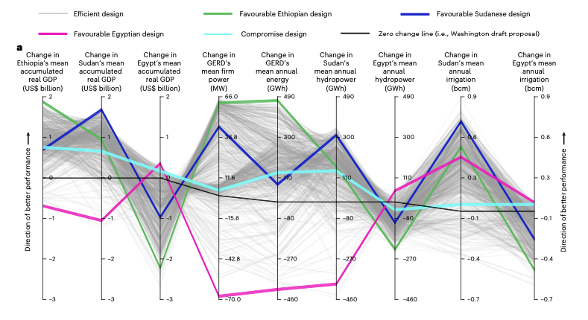
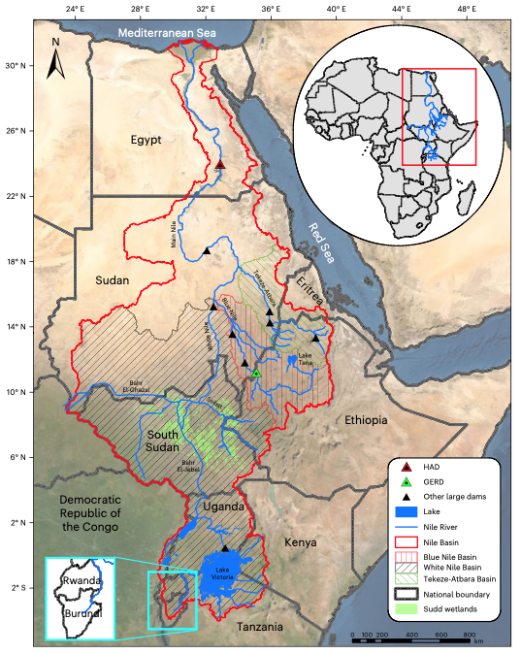
Example 2 – designing more resilient and equitable futures for the Nile River Basin
Nile River basin represents a complex water-dependent system, with a legacy of cooperation but ongoing challenges over water-sharing
Grand Ethiopian Renaissance Dam (GERD) has potential to transform Ethiopian development but with impacts on downstream countries
Water-energy-food-economy modeling and multi-objective optimization can identify compromise cooperative solutions for dam operations and water management
Compromise solution
Nationally favourable solutions
Current proposed solution
Notes:
Overall approach is to use coupled models to explore systemic resilience under different water futures and identify optimal solutions or pathways. I would be happy to chat about any of this and other water-climate related research. Many thanks

Slide 19
Participant Introductions
Introductions and and background to each represented institution, including overview of current approaches and needs.
Zimbabwe
The Zimbabwe Meteorological Services Department ( ZMSD)
The Department of Civil Protection( DCP)
The Zimbabwe National Water Authority (ZINWA)
Mozambique
INAM: Instituto Nacional de Meteorologia (Mozambique National Institute of Meteorology) ; INAM Sofala, INAM Manica, INAM Inhambane
INGD: Instituto Nacional de Gestão e Redução do Risco de Desastres (National Institute for Disaster Risk Management and Reduction)
ARA Centro (Water Administration Institute for the Central Region of Mozambique), Buzi
ARA Centro, Pungue
ARA-Sul (Water Administration Institute for the Southern Region of Mozambique)
ICS: Instituto De Comunicacao Social

Slide 20
Discussion on current capacities and gaps
In small groups, discuss and report back:
What are the strengths in current approaches to EWS in your institution and country, including technical methodologies and capacities?
What are the gaps?
Em pequenos grupos, discutam e relatem:
Quais são os pontos fortes das actuais abordagens ao EWS na sua instituição e país, incluindo metodologias e capacidades técnicas?
Quais são as lacunas?

Slide 21
BuPuSa Flood and Drought Monitor
Lecture 1: Introduction to the BuPuSa-FDM and its potential use

Slide 22
Buzi-Pungwe-Save Flood and Drought Monitor
“BuPuSa-FDM”
An online platform for monitoring water resources, floods and droughts, close to real-time for the BuPuSa basins
Provides daily updates of hydrological variables, flood and drought indices
Provides short-term flood and drought forecasts
Data available back to 2000 for estimating risk
This pilot version can be upgraded in many ways …

Slide 23
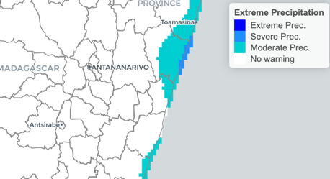
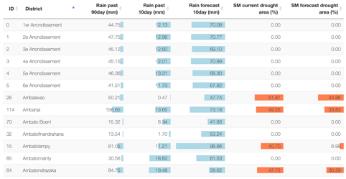
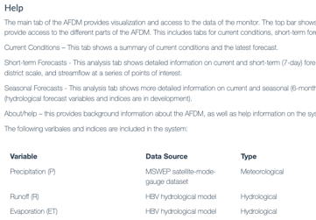
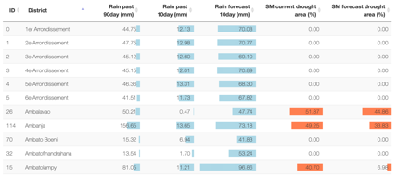
Overview of the Web Interface
Current Warnings
Country and District Summaries
Help and About
Summary of current conditions including areas in drought or wet conditions
Zoom in to show country level
Select different variables and drought/flood indices
Select different overlays and ways to extract summary information
Animate maps over recent past
Recent changes and forecasts in flood, drought and hydrological variables
Map of current hydrological and drought/flood conditions

Slide 24
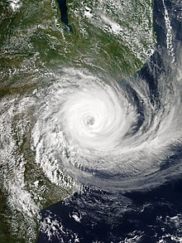
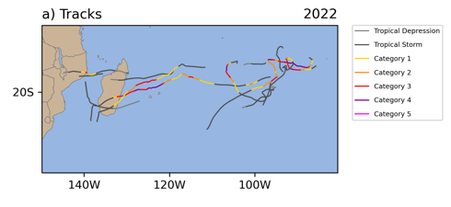
Why do we need a Flood/Drought Monitor for the BuPuSa basins?
The region is sensitive to climate across multiple sectors (hydropower, agriculture, transport, infrastructure, health, …), with potential for longer-term impacts of structural transformations, migration and conflict.
Climate adaptation is a key part of sustainable and inclusive growth across the country and wider continent – inaction will be more costly with the poorest affected most.
Climate mitigation also needs to be addressed - transition to renewables, sustainable agriculture and land use including carbon sequestration and reduced emissions, … all of which are climate/water sensitive
Climate information and services are critical for hazard alerts, early warning, short-term planning, long-term adaptation, climate change mitigation, …
Recent cyclone flooding/damage (e.g. cyclone Idai, Kenneth, Freddy) and drought conditions during 2023/4 across southern Africa highlight the need for more proactive approaches to climate risk management and reduction, including adaptation/mitigation.
Tropical Cyclone tracks, 2022
Tropical Cyclone Idai, 2019

Slide 25
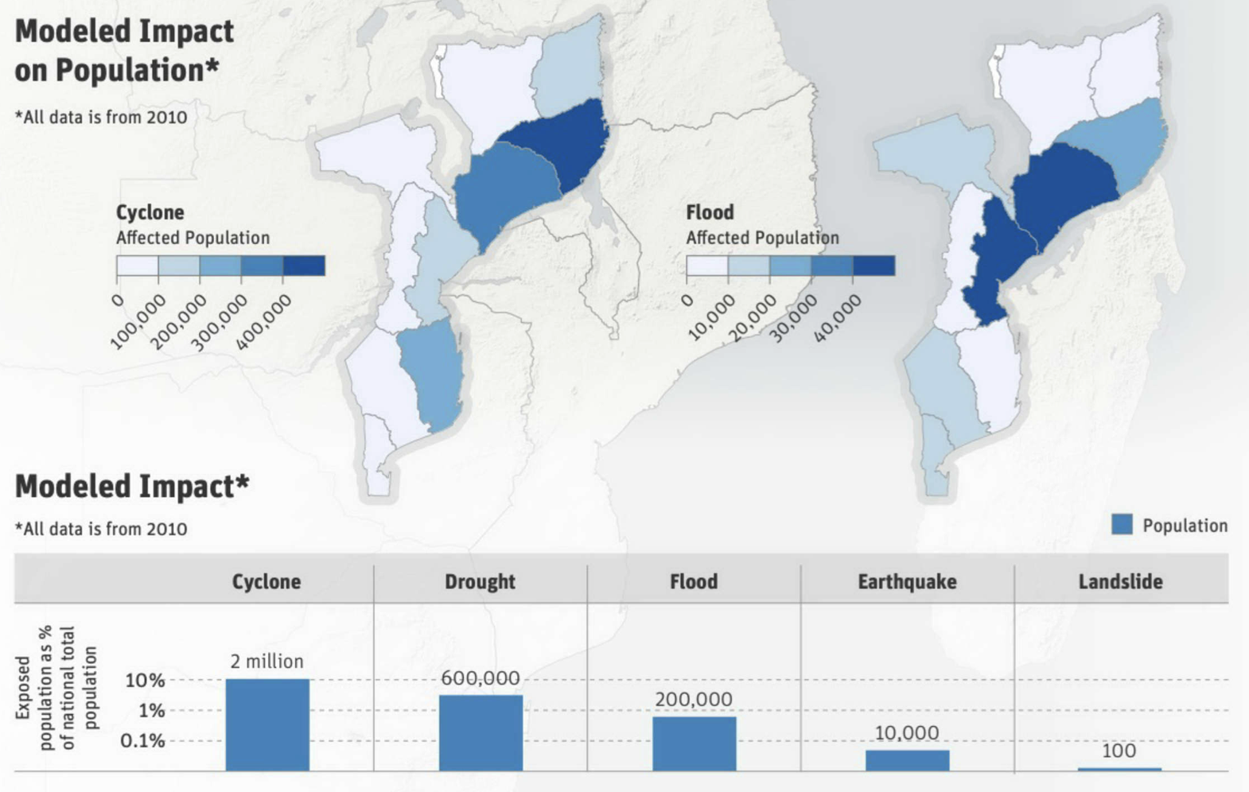
Hazards Risk Profile for Mozambique
Mozambique is prone to a variety of hazards, which, when combined social, economic, demographic, health and environmental factors, make the population highly vulnerable to disaster risks.
The natural hazards that occur most frequently are cyclones, flood (riverine, coastal), droughts (and water scarcity), extreme heat and wildfires, landslides, ... plus geohazards (earthquakes, rockfalls) and epidemics.
Little information is available on economic losses; however, cyclone, flood and drought extremes are estimated to have caused the most damage economically.
Climate Risk Profile: Mozambique (2021): The World Bank Group

Slide 26
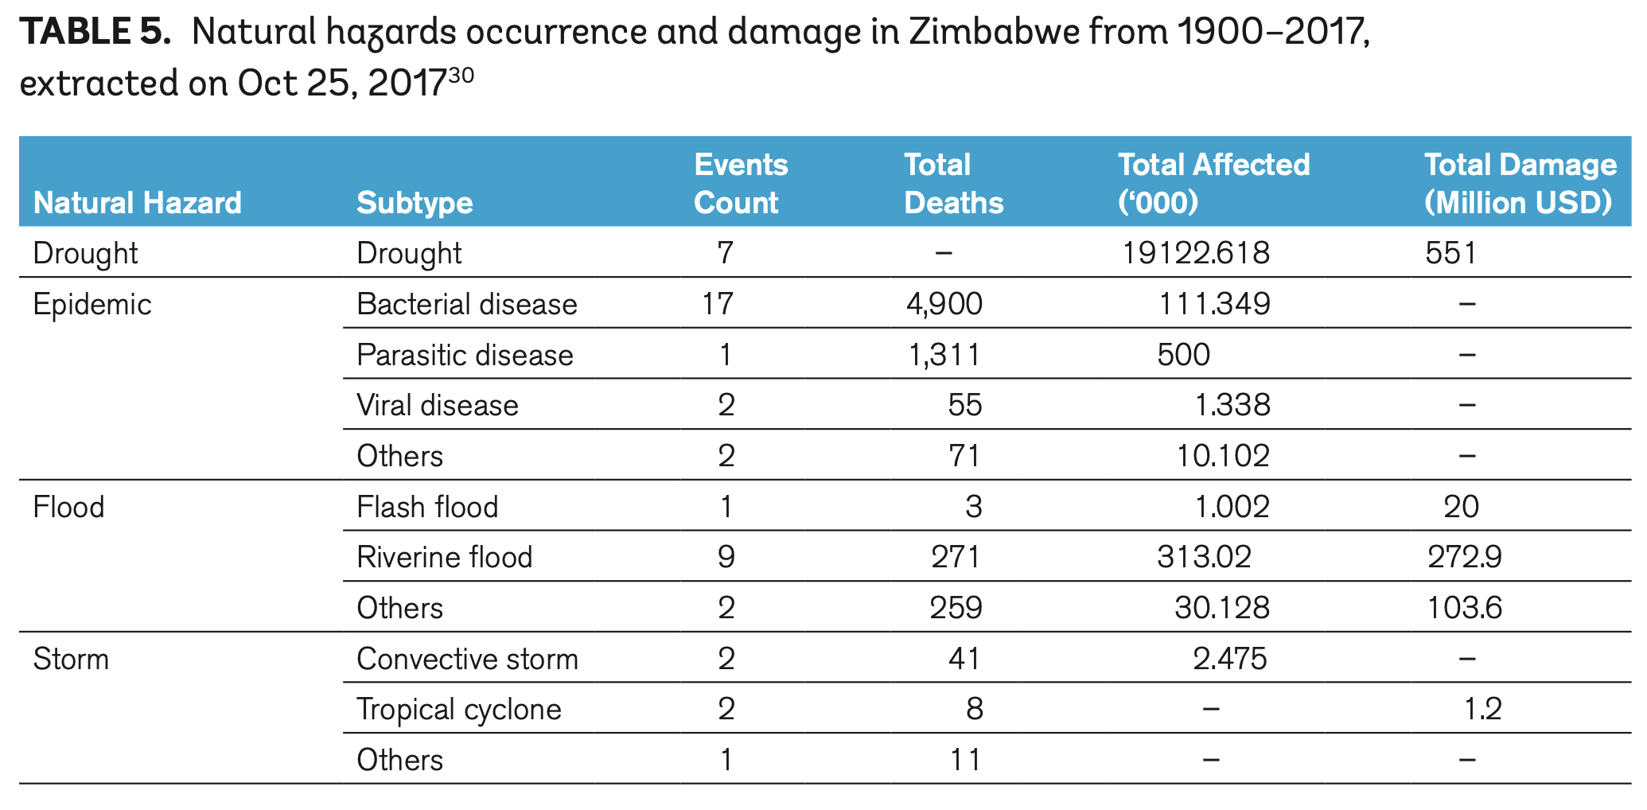
Hazards Risk Profile for Zimbabwe
Zimbabwe is also prone to a variety of hazards, which, when combined social, economic, demographic, health and environmental factors, make the population highly vulnerable to disaster risks.
The natural hazards that occur most frequently are droughts (and water scarcity), flood (riverine, coastal), cyclones, extreme heat and wildfires, landslides, ... plus geohazards (earthquakes, rockfalls) and epidemics.
Little information is available on economic losses; however, drought and floods are estimated to have caused the most damage economically.
Climate Risk Profile: Zimbabwe (2021): The World Bank Group

Slide 27
The BuPuSa-FDM is a Flood and Drought Monitoring and Early Warning System that forms part of flood and drought risk management
Prediction and
Early Warning
Preparedness
Risk Management
PROACTIVE
Mitigation
Disaster
Protection
Managing the risk of impacts relies on
a variety of measures to reduce vulnerability
that includes forewarning through early-warning systems.
Recovery
Impact
Assessment
Reconstruction
Crisis Management
REACTIVE
Recovery
Response
Adapted from WMO

Slide 28
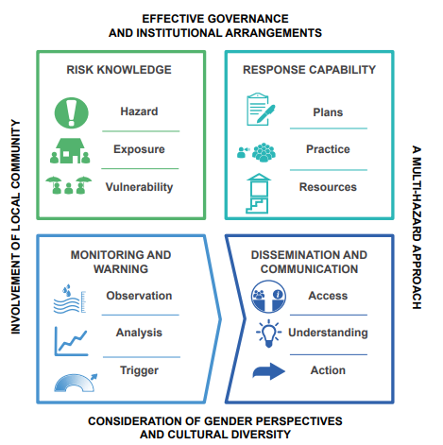

What is an early warning system?
UNDRR definition:
An integrated system of hazard monitoring, forecasting and prediction, disaster risk assessment, communication and preparedness activities systems and processes that enables individuals, communities, governments, businesses and others to take timely action to reduce disaster risks in advance of hazardous events.
disaster risk knowledge based on the systematic collection of data and disaster risk assessments;
detection, monitoring, analysis and forecasting of the hazards and possible consequences;
dissemination and communication, by an official source, of authoritative, timely, accurate and actionable warnings and associated information on likelihood and impact; and
preparedness at all levels to respond to the warnings received.
These four interrelated components need to be coordinated within and across sectors and multiple levels for the system to work effectively and to include a feedback mechanism for continuous improvement.

Slide 29
What is an early warning system?
UNDRR definition:
An integrated system of hazard monitoring, forecasting and prediction, disaster risk assessment, communication and preparedness activities systems and processes that enables individuals, communities, governments, businesses and others to take timely action to reduce disaster risks in advance of hazardous events.
disaster risk knowledge based on the systematic collection of data and disaster risk assessments;
detection, monitoring, analysis and forecasting of the hazards and possible consequences;
dissemination and communication, by an official source, of authoritative, timely, accurate and actionable warnings and associated information on likelihood and impact; and
preparedness at all levels to respond to the warnings received.
These four interrelated components need to be coordinated within and across sectors and multiple levels for the system to work effectively and to include a feedback mechanism for continuous improvement.
Multi-hazard early warning systems address several hazards and/or impacts of similar or different type in contexts where events may occur alone, simultaneously, cascadingly or cumulatively over time, and taking into account the potential interrelated effects.
A multi-hazard early warning system with the ability to warn of one or more hazards increases the efficiency and consistency of warnings through coordinated and compatible mechanisms and capacities, involving multiple disciplines for updated and accurate hazards identification and monitoring for multiple hazards.

Slide 30

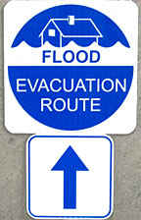
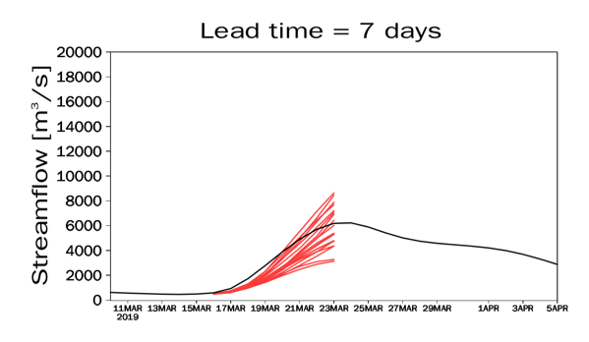
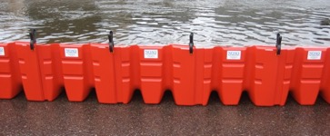
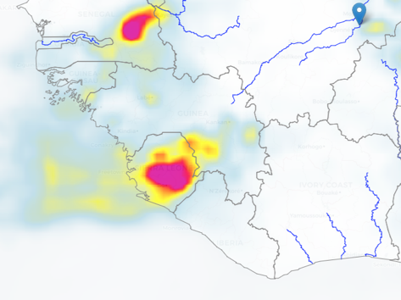
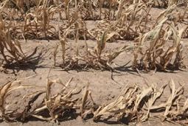

Monitoring and early warning can be used for …
1) Flood alerts and early warning
Flood Mitigation Options
Short-term streamflow forecast
Potential to reduce impacts via warning, evacuation, barriers, insurance, …
2) Agricultural management
Various agricultural management practices
Extreme heat and flash drought – irrigate?
Frost damage – cover crops?
Short-term weather forecast
Potential to reduce losses with short-term interventions
Extreme precipitation and flooding – harvest early?

Slide 31
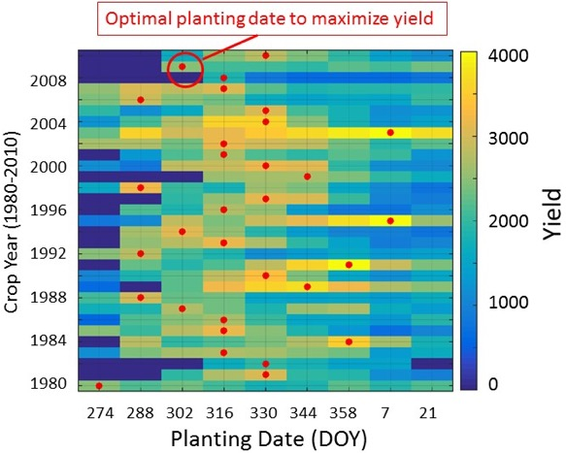
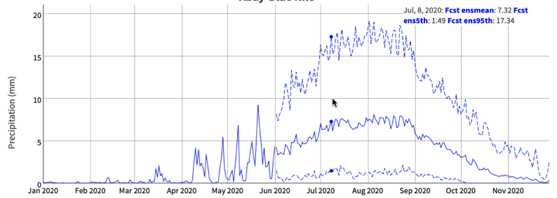
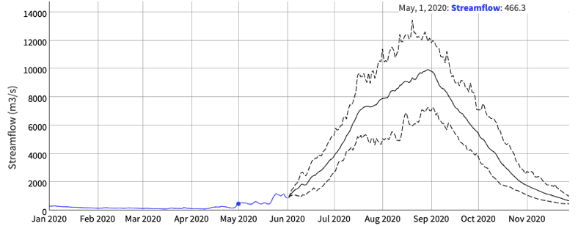
Monitoring and Early Warning can be used for …
3) Agricultural planning
Seasonal precipitation forecast
Potential decision on when to plant
and what to plant
4) Water resources management
Reservoir Management Options
Seasonal streamflow forecast
Optimal reservoir management during drought conditions

Slide 32
Can the BuPuSa-FDM be useful for EW?
Questions for you by end of the workshop
Is the system useful for monitoring and early warning of floods and droughts?
Does it complement / enhance existing approaches?
How can it be updated and improved to be useful?
Are the national systems useful also?

Slide 33
BuPuSa Flood and Drought Monitor
Lecture 2: Overview of the data, models and methods

Slide 34
Buzi-Pungwe-Save (BuPuSa-FDM)
An online platform for monitoring water resources, floods and droughts, close to real-time for the BuPuSa basins
Provides daily updates of hydrological variables, flood and drought indices
Provides short-term flood and drought forecasts
Data available back to 2000 for estimating risk
This pilot version can be upgraded in many ways …

Slide 35
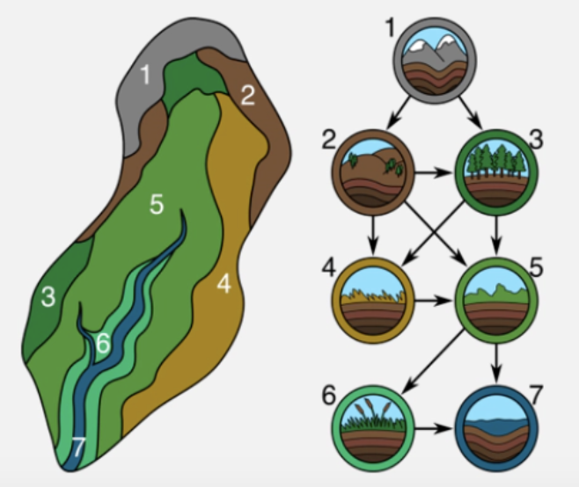

Overall Approach
The BuPuSa-FDM integrates multiple sources of information from ground observations, satellite remote sensing and climate and hydrological models to provide the best estimate of hydrological, flood and drought conditions historically and in near real-time.
At the core of the system is the Hydroblocks hydrological model which provides estimates hydrological variables and are used to develop flood/drought indices - daily resolution, and on a 5km/30m grid, or high-definition vector river network, depending on the variable.
The historical data covers the period 2000-present and can be used to develop hazard risk assessments.
The real-time monitoring, coupled with the risk assessments, form the basis for early warning.
The system is intended to run operationally, less than 1 day behind real-time, which is dictated by the availability and latency of the satellite and model data products.

Slide 36


The Monitoring and Forecasting Approach
Real-time climate data
Hydrological models
Hydrologic (initial) conditions
Soil moisture
Groundwater
Streamflow
…
Real-time monitoring - updated every day
PGF
Princeton Global Forcings
+
HB +
RAPID + Inun
Short-term weather forecasts
Hydrological models
Forecasts out to 10 days:
Precip., Evap, Runoff,
Streamflow + index
Soil moisture + index
SPI
…
Short-term forecasts - updated every day
+
HB +
RAPID + Inun
Seasonal climate forecasts
Hydrological models
Forecasts out to 6 months:
Precip., Evap, Runoff,
Streamflow + index
Soil moisture + index
SPI
…
Seasonal forecasts - updated every month
+
Not implemented (yet)
HB +
RAPID + Inun

Slide 37


Hydrological Models
The Hydroblocks model – a comprehensive land surface hydrological model, a recently developed model that can be applied at high resolution (10s metres) for multiple ensemble forecasts
Hydroblocks predicts runoff for each grid cell, which is then passed to RAPID to predict streamflow for ~3,600 reaches
RAPID streamflow routing model:
a flexible framework for simulating on vector-based river networks at large-scale.

Slide 38
Hydrological Model - Hydroblocks
The Hydroblocks model is a comprehensive semi-distributed model capable of simulating the main fluxes and states of the terrestrial water cycle over large spatial domains.
It simulates at high-resolution (10s metres) by using a clustering approach based on gridded landscape datasets (30-250m) (see Figure).
Parameters such as land cover, slope, elevation, and clay content are clustered on a sub-basin level to identify Hydrological Response Units (HRU), within which the hydrology is expected to respond in a uniform way, and which form the computational units of the Hydroblocks model.
Precipitation and other meteorological variables are used to drive the model which then provides estimates of soil moisture, runoff and evapotranspiration that are used to develop drought/flood indices.
Estimates of these variables at 30m are calculated based on mapping the results for each HRU to 30m based on the original 30-250m gridded landscape datasets.

Slide 39

The Need for Approaches at Fine Scale (10s metres)
Landscape heterogeneity and intermittent rainfall leads to high spatial (and temporal) variability in soil moisture, drought, runoff generation and flooding.
Soil moisture over a 100x100km domain
Soil moisture over a 10x10km domain
Land surface imagery over a 10x10km domain

Slide 40

Local landscape and hydrological variability are important
Heterogeneity at smallholder farm scale drives variable flood and drought occurrence and impacts
There is a spatial scale mismatch between drought indices from models or satellites (1-10 km) and fields (0.5-1 ha area) or complex urban areas
Leads to a disconnect between flood and drought monitoring and EW and impacts on the ground.
This limits monitoring of local-scale flood and drought impacts, particularly for smallholder farming systems, and other high-complexity landscapes
Vergopolan et al., HESSD, 2021; Vergopolan et al., in prep.

Slide 41

A Solution: Hydroblocks high resolution hydrological model
Modeling at high resolution of the field scale (10s meters) is impossible over large areas – computational/data limitations
Clustering of the landscape can address this challenge, by assuming that similar landscape areas behave the same hydrologically (Hydrological Response Units, HRU)
The model runs at the HRU scale and then projects the outputs to 10s meters scale based on the landscape data

Slide 42

Clustering the landscape to increase computational efficiency by using the repeating patterns of the landscape
Chaney, et al., 2018: Harnessing big data to rethink land heterogeneity in Earth system models, Hydrol. Earth Syst. Sci., 22, 3311–3330, https://doi.org/10.5194/hess-22-3311-2018

Slide 43




First Demonstration of Hydroblocks for the US
- merged with satellite soil moisture data
Combining HydroBlocks “hyper-resolution” model with SMAP satellite retrievals to estimate surface soil moisture across the US at 30m resolution
Vergopolan et al., HESSD, 2021; Vergopolan et al., 2021.

Slide 44
Hydroblocks Clustering Approach for the BuPuSa
Maps of 100m land cover, 30m elevation, and 250m soil properties and sub-basins that are used to cluster the landscape into HRUs for the Hydroblocks model.
The hydrology is expected to respond in a uniform way within each HRU.
The HRUs form the computational units of the Hydroblocks model.
Land cover - Copernicus 100m V3.0.1 based on PROBA-V satellite observations
Elevation - Copernicus 30m Global Digital Elevation Model
Soils (SoilGrids 250m; Hengl et al., 2017)
HydroSheds sub-catchment definitions

Slide 45

Hydroblocks Clusters
Distribution of HRUs across the BuPuSa basins. HRUs are developed by clustering landscape parameters (elevation, land use and soil type), and form the computational elements for the Hydroblocks model. Colors are randomly assigned to HRU numbering within sub-basins.
The HRU approach reduces the number of computational units by 1000-10000 times, therefore decreasing run-time and allowing more ensemble forecasts to be run.

Slide 46


The Streamflow Routing Model - RAPID
RAPID streamflow routing model (Routing Application for Parallel computation of Discharge; David et al., 2011; David, 2019)
A flexible framework for simulating on vector-based river networks at large-scale.
Solves a matrix version of the Muskingum method which incorporates the continuity equation with a lumped storage-discharge relationship
k is a time (k ≥ 0) related to the celerity of the flow wave
x is a non-dimensional parameter (0 ≤ x ≤ 0.5) related to diffusion of the flow wave

Slide 47


Flood Inundation Model
To complement the hydrological and streamflow modelling, there is satellite based regional flood inundation monitoring at 10m resolution.
The system also provides 1-, 3-, and 10-day lead-time forecasts at 10m resolution.
Machine-learning (ML) is used to downscale coarser-resolution (36-km) NASA SMAP (Soil Moisture Active Passive) microwave fractional water inundation (FW) retrievals.
The target variable for the ML is the Google Dynamic World 10-m near-real-time (NRT) Land Use/Land Cover (LULC) dataset that includes class probabilities and label information for nine classes, including for open water or flooded vegetation.
The inundation forecasts assume that rainfall-driven flood inundation patterns are primarily governed by soil infiltration and saturation excess runoff mechanisms, whereas inundation spatial variability is controlled by topography, soil, rainfall, and vegetation properties.
Flood inundation associated with Cyclone Idai, 19 March 2019

Slide 48

Meteorological Forcing Data
We use the ERA5 reanalysis as the basis for precipitation and other meteorological variables (e.g. temperature, windspeed) for the historic simulation and up to about a month from real-time.
The ERA5 data have been shown to perform well when compared to station data and against other gridded products, but has not been evaluated specifically for the BuPuSa region. Gridded precipitation products are challenged in the tropics and sub-tropics, particularly for intermittent and localized convective precipitation.
Potentially needs bias correction and merging with other datasets (e.g., satellite)
Are station data available to evaluate?
For near real-time updates we use the US National Center for Environmental Prediction (NCEP) Global Data Assimilation System (GDAS), which is used to initialize the US Global Forecasting System (GFS). Precipitation and meteorological forecasts from the ensemble version of the GFS (GEFS) are used to force the short-term hydrological forecasts in the system.

Slide 49
Hydroblocks-RAPID historic simulation 2000-2022
The Hydroblocks and RAPID models run historically for 2000-2022 - forced by ERA5 precipitation and other meteorological variables.
The reconstructed hydrologic variability for runoff, soil moisture, evapotranspiration, streamflow etc have been evaluated by comparing to available streamflow observations and independent satellite-based estimates of soil moisture.
Some examples of system outputs from the historic Hydroblocks simulation (2000-2021) are shown in the Figure, for soil moisture, latent heat flux, surface temperature and surface runoff.
Figure. Snapshots of Hydroblocks outputs for surface soil moisture, latent heat flux, surface temperature and surface runoff.

Slide 50

Hydroblocks-RAPID validation - Streamflow
We evaluated the modeled streamflow data against daily observations from the Global Runoff Data Centre (GRDC) for 4 and 26 stations, for Mozambique and Zimbabwe, respectively, within the BuPuSa basins.
The GRDC data are only available up until about 1990 (and with missing data at many stations), which does not overlap with the Hydroblocks modeling period of 2000-2022.
We therefore compare with the simulations from the ZIM-FDM and MOZ-FDM national monitoring systems, which use similar but coarser modeling approaches.
The model generally performs well but is too wet and variable compared to the observations.
Figure. Spatial distribution of error statistics for modeled streamflow over the BuPuSa basins compared to GRDC observations.

Slide 51



Hydroblocks-RAPID validation –
some example streamflow stations
Time series of modeled and observed daily streamflow at three example gauging stations in the BuPuSa basins.
Are there more recent streamflow observations available to validate the model?

Slide 52

Hydroblocks-RAPID validation of Soil Moisture
For soil moisture, we compare with the European Space Agency's Climate Change Initiative for Soil Moisture (ESA-CCI SM v08.1) product, which harmonizes and merges soil moisture retrievals from active and passive microwave satellite sensors to consistent daily, global maps of near-surface soil moisture at 0.25-degree spatial resolution.
Figure. Comparison of monthly average top layer soil moisture between the ESA-CCI satellite based estimate and the Hydroblocks estimate for 2000 to 2022.

Slide 53

Hydroblocks-RAPID validation of Evaporation
We also compare with a satellite-model based estimate of evaporation: a recent version of the GLEAM dataset, V3.6a, which is a global dataset spanning 1980–2021 at 0.5-degree, daily resolution, and is often used as a benchmark dataset for evaporation.
Figure. Comparison of monthly average evaporation between the GLEAM satellite-based estimate and the Hydroblocks estimate for 2000 to 2021.

Slide 54

Flood Inundation Evaluations
Comparison with flood maps independently derived by the NASA JPL Advanced Rapid Imaging and Analysis (ARIA) project from space-borne Sentinel-1 Synthetic Aperture Radar (SAR) observations on March 19, 2019 when the flood peak occurred.
Relatively large uncertainties are expected in the ARIA SAR-based flood maps over urban areas and land with moderate to dense vegetation cover.
Figure. Inundation maps for March 19, 2019 produced by ARIA using Sentinel-1 SAR observations (a), machine-learning based downscaling from SMAP fractional water product (b), 1-day forecast (c), 3-day forecast (d), and 10-day forecast (e) for March 19, 2019 when peak flood occurred during the Cyclone Idai event.

Slide 55
Any questions?

Slide 56
BuPuSa Flood and Drought Monitor
Lecture 3: Overview of flood and drought representation
in the system

Slide 57
Flood Products in the BuPuSa-FDM
Variable | Data source | Type | Attributes
Precipitation (P) | PGF |  | 5km, daily
Runoff (R) | HB |  | 30m, daily
Evaporation (ET) | HB |  | 30m, daily
Soil moisture (SM) | HB |  | 30m, daily
Streamflow (Q) | HB+RAPID |  | River reach, daily
Index | Data source | Flood Type | Attributes
P percentile | PGF | Potential flooding from rainfall - heavy (R95) or extreme (R99) | 5km, daily
SPI | PGF | Meteorological – indicates longer-term wet conditions | 5km, daily, SPI-1, -3
SM standardized anomaly | HB | Agricultural – indicates wet soils and potential water logging | 30m, daily
Q percentile | HB+RAPID | Hydrological – indicates flood flows above Q95 or Q99 | Reach, daily
Inundation | ML | Surface flooding | 10-30m, daily

Slide 58


Flood indices: Heavy or Extreme Rainfall
Large precipitation events that can potentially cause flooding are identified based on percentile thresholds
Heavy precipitation is defined as the daily precipitation amount over the 95th percentile
Extreme precipitation is above the 99th percentile
Precipitation percentile threshold P_{t} (mm/day)
Exceedance probability F (%)
P_{t}
Cumulative probability G (%)
Schär, et al. 2016: Climatic Change

Slide 59



Flood indices: Soil Moisture Index
Very wet soil moisture reflects water logging and flood potential
Soil moisture values are standardized by shifting by the mean and scaling by the stdev
Also known as a z-score
Time series of SM
PDF of SM
PDF of SM index
Mild wetness
Moderate wetness
Severe wetness
Extreme wetness

Slide 60


Flood indices: Streamflow Index
Many ways to define a streamflow flood
By recurrence interval, by level, by duration, …
We use percentile values (annual) as threshold to define flood events as:
Moderate 90th pctl
Severe 95th pctl
Extreme 99th pctl

Slide 61
Drought Products in the BuPuSa-FDM
Variable | Data source | Type | Attributes
Precipitation (P) | PGF |  | 5km, daily
Runoff (R) | HB |  | 30m, daily
Evaporation (ET) | HB |  | 30m, daily
Soil moisture (SM) | HB |  | 30m, daily
Streamflow (Q) | HB+RAPID |  | River reach, daily
Index | Data source | Drought Type | Attributes
SPI | PGF | Meteorological | 5km, daily, SPI-1, -3
SM standardized anomaly | HB | Agricultural | 30m, daily
Q percentile | HB+RAPID | Hydrological | Reach, daily

Slide 62

Meteorological Drought: SPI – Standardized Precipitation Index
T.B. McKee, N.J. Doesken and J. Kleist, Colorado State University, 1993

Slide 63

Agricultural Drought: SM Index
Low soil moisture values indicate potential impacts of agriculture and natural vegetation
Soil moisture values are standardized by shifting by the mean and scaling by the stdev
Also known as a z-score
Time series of SM
PDF of SM
PDF of SM index

Slide 64

Hydrological Drought: Streamflow percentiles
Streamflow drought index is based on percentile values.
Streamflow (m3/s) is converted into percentiles using a 30-day running window.
Current streamflow values are compared against a drought threshold of the 20th percentile, and duration and deficit (severity) can be calculated.
Drought threshold

Slide 65
BuPuSa Flood and Drought Monitor
Lecture 4: Overview of flood and drought forecasting
in the system

Slide 66
General Approach to Hydrological Forecasting
Climate model forecasts
Downscaling/bias correction
Typical modeling chain
Hydrological model
Drought indices and
data products

Slide 67
Our Approach to Hydrological Forecasting
Climate model forecasts
Downscaling/bias correction
Hydrological model
Drought indices and
data products
Ensemble forecasts out to 7-days and 6 months:
Precip., Evap, Runoff,
Streamflow + index
Soil moisture + index
SPI
…

Slide 68
Operational Forecasting
Real-time monitoring - updated every day
Real-time climate data
Hydrological model
Hydrologic initial conditions
Soil moisture
Groundwater
Streamflow
…
PGF
Princeton Global Forcings
+
HB +
RAPID + Inun
Short-term or seasonal climate forecasts
Hydrological model
Forecasts out to 7 days or out to 6 months:
Precip., Evap, Runoff,
Streamflow + index
Soil moisture + index
SPI
…
+
HB +
RAPID + Inun
Short-term forecasts – updated every 1-3 days
Seasonal forecasts - updated every month

Slide 69
Forecast Flood Products in the BuPuSa-FDM
In general, forecasts are available for all meteorological and hydrological variables: precipitation, runoff, evapotranspiration, streamflow, …
But there are also forecasts of specific flood variables and indices:
Index | Data source | Flood Type | Attributes
P percentile | PGF | Potential flooding from rainfall - heavy (R95) or extreme (R99) | 5km, daily
SPI | PGF | Meteorological – indicates longer-term wet conditions | 5km, daily, SPI-1, -3
SM standardized anomaly | HB | Agricultural – indicates wet soils and potential water logging | 30m, daily
Q percentile | HB+RAPID | Hydrological – indicates flood flows above Q95 or Q99 | Reach, daily
Inundation | ML | Surface flooding | 10-30m, daily

Slide 70
Source of Uncertainty
Uncertainties derive from model uncertainty and data uncertainty (initial conditions)
Uncertainties in the climate forecasts:
Climate model structure and parametrizations
Initial conditions of the climate forecast (state of the atmosphere)
Uncertainties in the hydrological forecast:
Hydrological model structure and parametrizations
Initial conditions of the hydrological forecast (state of the land surface)

Slide 71
Comparing uncertainty in initial conditions and in model structure

Slide 72
Sources of Uncertainty – in the BuPuSa-FDM System
Uncertainty in the historic climate data
Uncertainty in the historic hydrological simulation
Real-time climate data
Hydrological model
Hydrologic initial conditions
Soil moisture
Groundwater
Streamflow
…
Uncertainty in the initial conditions
PGF
Princeton Global Forcings
+
Short-term and seasonal climate forecasts
Hydrological model
Forecasts out to 7 days:
Precip., Evap, Runoff,
Streamflow + index
Soil moisture + index
SPI
…
Uncertainty in the forecast outputs
+
Uncertainty in the climate forecasts
Uncertainty in the hydrological forecasts

Slide 73

Representing Uncertainty in the FDM Forecasts
The uncertainty in hydrological forecasts are represented by the range of the ensemble
Here the forecasts show an increasing streamflow with increasing uncertainty over time
Note that the inundation forecasts are deterministic at present
The ensemble
95th percentile
The forecast
uncertainty
The ensemble
mean/median forecast
The ensemble
5th percentile
The historic data
The forecast data
The current data

Slide 74




Propagation of Uncertainty
Ensemble of precipitation (and temperature) forecasts
Ensembles of hydrological forecasts

Slide 75


Forecast Skill for River Flooding from Cyclone Idai
Example of forecast skill and ensemble spread for the peak flooding
on the Pungwe River, 11 March – 5 April
Pungwe River
Peak flow

Slide 76
Forecast Skill for River Flooding from Cyclone Idai
Example of forecast skill and ensemble spread for the peak flooding
on the Pungwe River, 11 March – 5 April
Peak flow

Slide 77

Forecast Skill for Flood Inundation from Cyclone Idai
Using ML to predict the area to be flooded in the next 24h
a) 24-hour forecast of inundated areas at 30-m resolution for the five sub-catchments of the lower Pungwe Basin, and b) effectively inundated areas during Cyclone Idai

Slide 78
Hydrometeorological Hazard Early Warning for the Buzi-Pungwe-Save (BuPuSa) Transboundary Basin
Technical Training and Knowledge Exchange Workshop
Prof. Justin Sheffield (sheffield.justin@gmail.com)
Princeton Climate Institute, USA
University of Southampton, UK

Slide 79
Day 2 – Training in the BuPuSa-FDM
Morning
Tour of the web interface
Exercises
Feedback and initial validation of the system and web interface
Afternoon
How to evaluate and validate the system
Discussion on multi-hazard early warning system
Way forward

Slide 80
Tour of the System

Slide 81

Training Materials
All materials and links to the system are here:
https://hydrology.soton.ac.uk/training.html
Training materials:
Overview presentation
Link to the BuPuSa-FDM
Self-guided exercise in how to use the system
Also links to the national systems for Zimbabwe and Mozambique to explore
Please note:
There is no registration or login required – the system is open access
The interface is written in the R language and uses the R-Shiny library
Some caveats:
A pilot version, still in development - there may be some missing information due to operational errors
The system takes a few seconds to initialize and render the maps/charts, but once loaded will be very responsive
We value your feedback!

Slide 82

Exercises in the use of the FDM
Self-guided exercises using the User Guide
Will take about 1 to 1.5 hours
Individually or in groups
Please ask questions as you complete the exercises

Slide 83
Initial Feedback
What works well with the system? What does not work so well?
Is the system useful? In what ways could you use it in your work?
Do the values of precipitation, streamflow, etc, look reasonable?
How can the system be validated?
What is missing from the system? What new data or functionality would be useful?
O que funciona bem com o sistema? O que não funciona tão bem?
O sistema é útil? De que forma você poderia usá-lo em seu trabalho?
Os valores de precipitação, vazão, etc. parecem razoáveis?
Como o sistema pode ser validado?
O que está faltando no sistema? Que novos dados ou funcionalidades seriam úteis?

Slide 84
Group discussion
What would be your ideal/perfect Early Warning System?
What prevents us from developing and operating the perfect system?

Slide 85
Way forward
How to validate? What data are available? Who can do it?
How to integrate observational real-time data into the system?
How to ensure the system is sustainable and accessible? Is there potential to transfer the technology?
Communication channels for updates and feedback.
Anything else?
Caminho a seguir
Como validar? Que dados estão disponíveis? Quem pode fazer isso?
Como integrar dados observacionais em tempo real ao sistema?
Como garantir que o sistema seja sustentável e acessível? Existe potencial para transferir a tecnologia?
Canais de comunicação para atualizações e feedback.
Algo mais?

